Slide 1
Cause of Death

Slide 2
Problem Statement
Around 58 million people die each year worldwide.
What caused their death?
How did the causes of death change over time and differ between different countries and world regions?
These are the big questions we are answering here by analysing the given dataset.

Slide 3
About the dataset
The dataset contains 6120 observation and 34 columns in each observation
The above dataset contains 30 years data of 240 countries.
The key features of dataset are: Meningitis, Alzheimer's Disease and Other Dementias, Parkinson's Disease, Nutritional Deficiencies, Malaria, Drowning, Interpersonal Violence, Maternal Disorders, HIV/AIDS, Drug Use Disorders, Tuberculosis, Cardiovascular Diseases, Lower Respiratory Infections, Neonatal Disorders, Alcohol Use Disorders, Self-harm, Exposure to Forces of Nature, Diarrheal Diseases, Environmental Heat and Cold Exposure, Neoplasms, Conflict and Terrorism, Diabetes Mellitus, Chronic Kidney Disease, Poisonings, Protein-Energy Malnutrition, Road Injuries, Chronic Respiratory Diseases, Cirrhosis and Other Chronic Liver Diseases, Digestive Diseases, Fire, Heat, and Hot Substances, Acute Hepatitis.

Slide 4
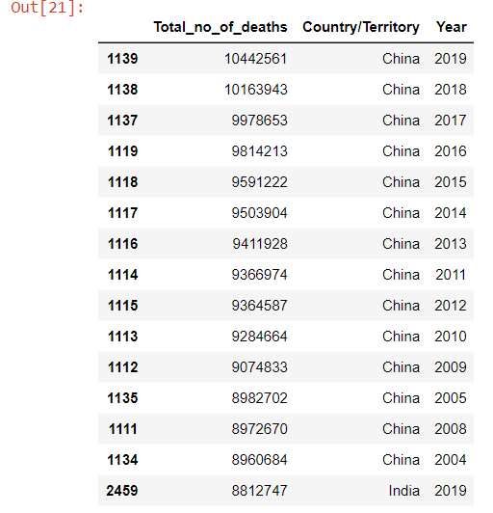
Top 40 Deaths Worldwide
Observation:-
In the list of Top-40 number of deaths China and India are at the top Because of the fact that they are most populated countries in the World.

Slide 5
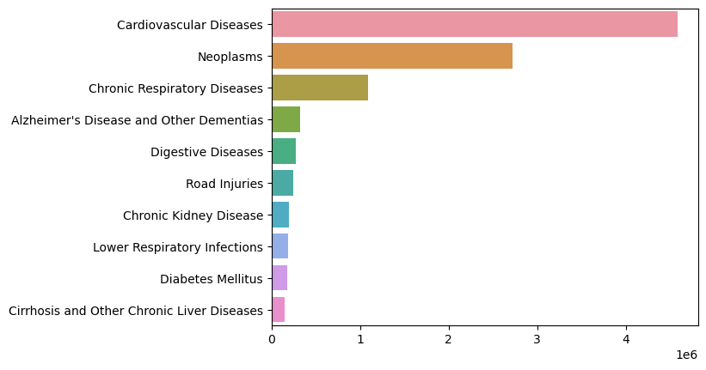
Top 10 Causes Of Death In China

Slide 6
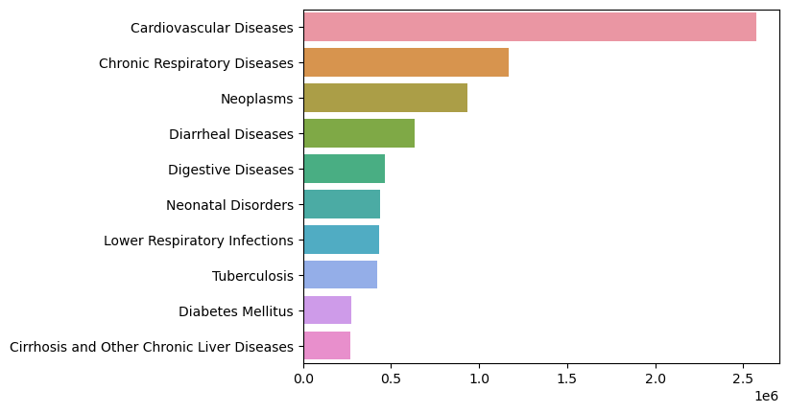
Top 10 Causes Of Death In India

Slide 7
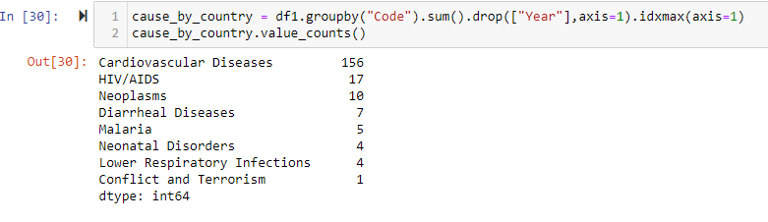
Which disease is the major cause of death ?
Observation :
Out of 204 countries in the dataset, cardiovascular diseases are a major cause of death for 156 countries.

Slide 8
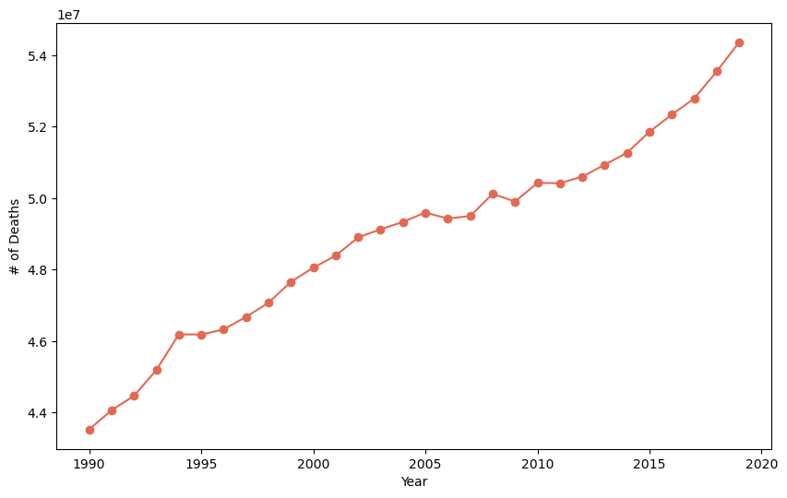
Which year is the deadliest ?
Observation:
Deadliest year appears to be 2019 in terms of death counts , however it was due to increase of the world population each year.

Slide 9
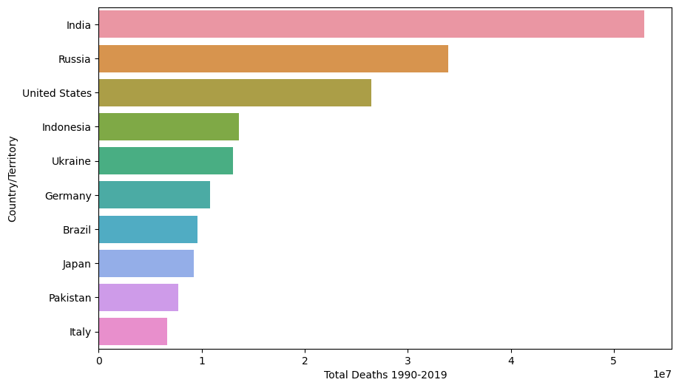
Which country suffered most from CVD?
Observation:-
India has highest number of deaths due to cardiovascular diseases followed by Russia and US.

Slide 10
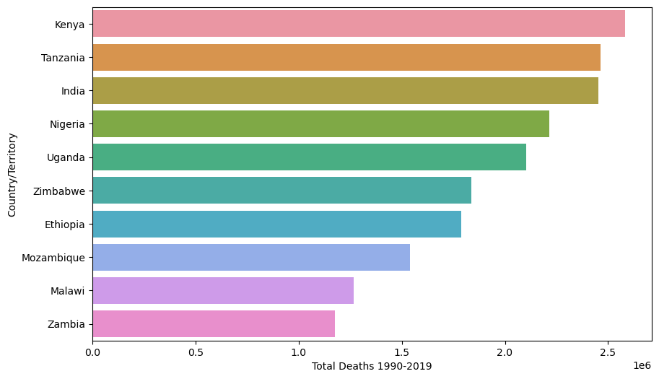
Which countries suffered from HIV/AIDS?
Observation:-
Across Sub-Saharan Africa the
deaths are much higher. Most
countries in the South of the region
had deaths greater than 1.5 Million.
In India the deaths due to HIV/AIDS
were nearly 2.5 millions

Slide 11
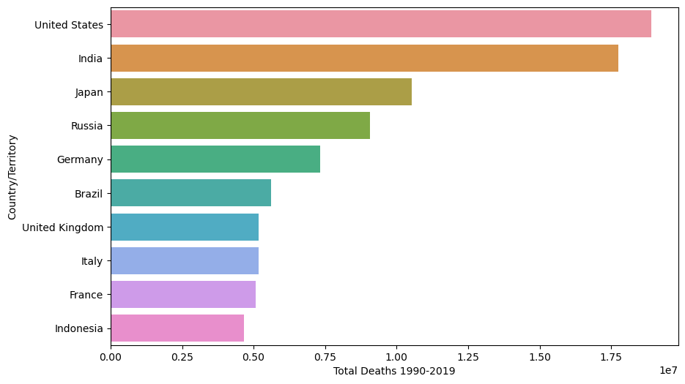
Which country suffered most from Neoplasm?
Observation:-
Cancer is a particularly common causes of death in richer countries where people are less likely to die of infectious disease and causes of deaths that lead to very early deaths for people in poverty.

Slide 12
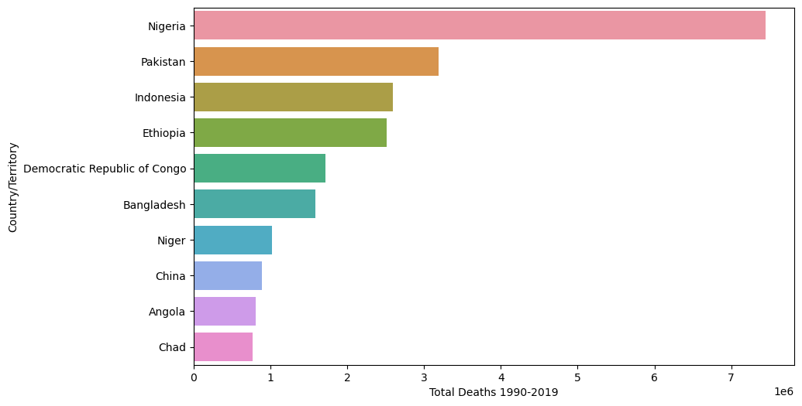
Which country suffered most from Diarrheal Diseases?
Observation:-
Diarrheal Diseases were the fourth leading cause of death in 2019. Overall, we see the highest morality in Sub-Saharan Africa and South Asia

Slide 13
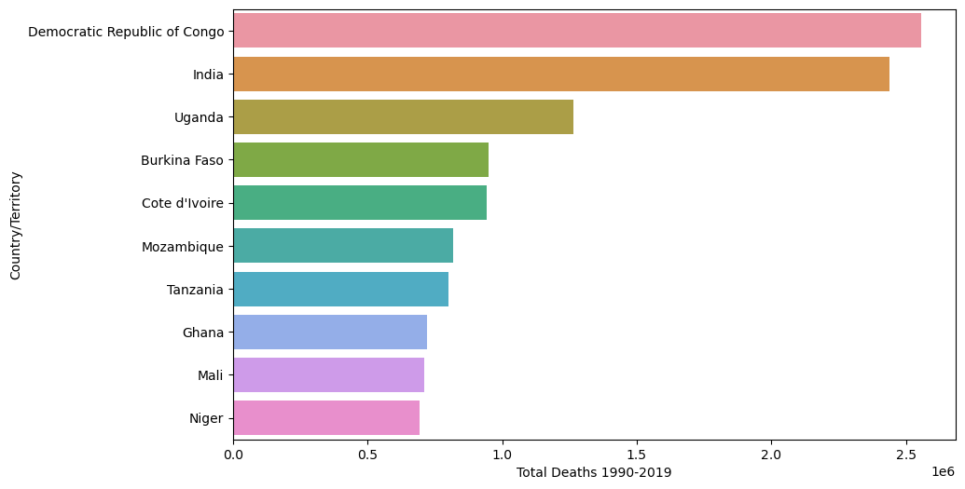
Which country suffered most from Malaria?
Observation:-
Africa is the country that is most affected by Malaria in last 30 years.

Slide 14
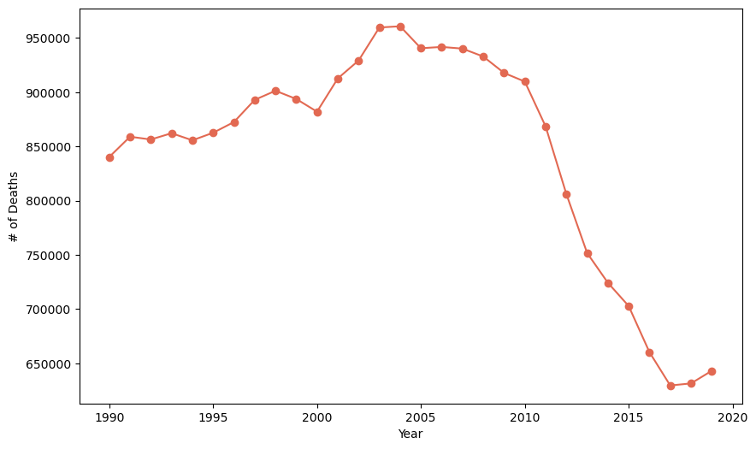
Which year suffered more deaths due to Malaria ?
Observation:-
Majority of global deaths from malaria occurred on the Africa continent. But Africa is also the world region that has achieved most progress: since 2000, deaths have fallen significantly.

Slide 15
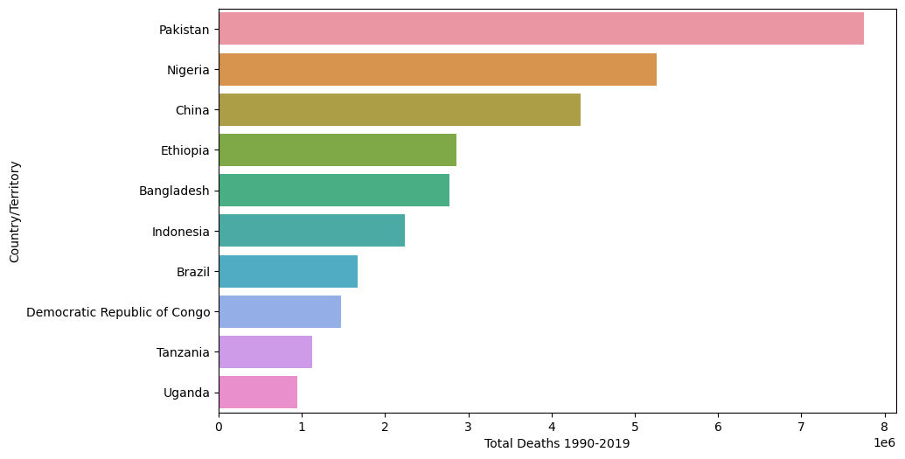
Which country suffered most from Neonatal Disorder?
Observation:-
The highest morality are seen across Sub-Saharan Africa and Asia.

Slide 16
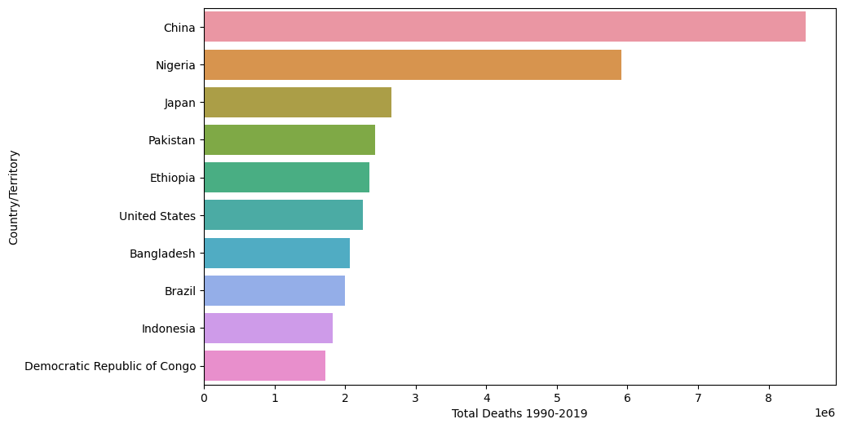
Which country suffered most from Lower Respiratory Infection?
Observation:-
China has highest number of deaths due to lower respiratory infections like Pneumonia.
USA is also in top 6 in number of deaths due to lower respiratory infections.

Slide 17
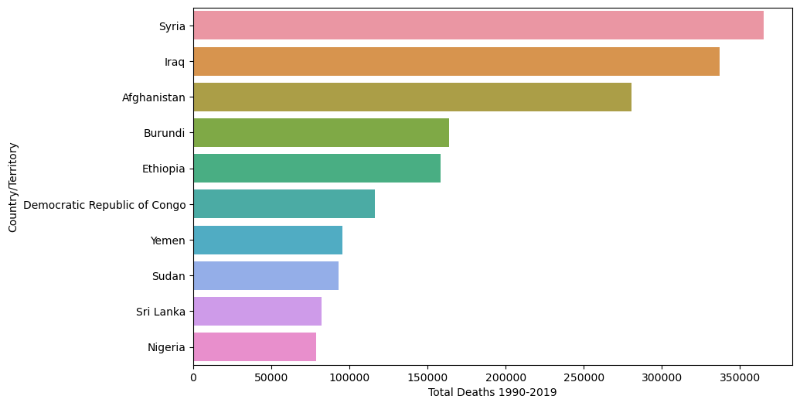
Which country suffered most Conflict And Terrorism ?
Observation:-
Most victims of terrorism die in the Middle East, Africa , And South Asia
Most are affiliated with well known terrorist groups , such as Islamic State, Taliban, Boko , Haram, And AI-Shabaab .

Slide 18
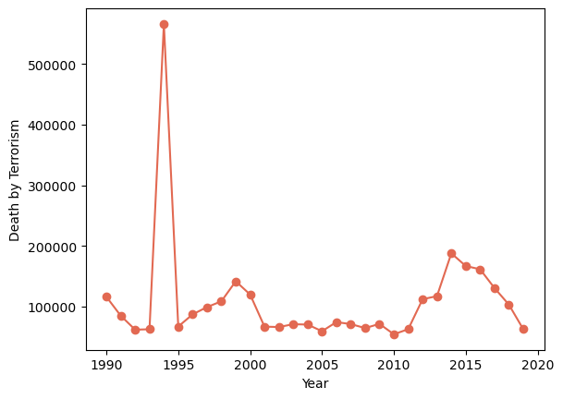
Which year have max death due to Conflict And Terrorism?
Observation:-
1994 was the year where the deadliest conflict took place in the World. Bosnian War in Europe may have contributed to its significant
After 2014, deaths due to conflicts and terrorism has been decreasing which is a good sign for the World.

Slide 19
Conclusion
Causes of Death vary significantly between countries: Non-communicable diseases dominate in rich countries, whereas infections diseases remain high at lower incomes.
Non- communicable diseases (NCDs) not only dominate morality figures at a global level, but also account for the majority of deaths in high income countries.
There are many diseases which continuously increasing such Neoplasms, HIV/AIDS,Diabetes,Cardiovascular Diseases, Digestive disorder and Alzheimer. Also there are many disease which are continuously decreasing too such as Acute Hepatitis, Diarrheal Diseases, Nutritional Diseases and Meningitis. Parkinson Diseases seems to be constants till 1990 to 1993 after that no data is present for the same.
In all the given years i.e. 1990 to 2019 ,Road accident have taken Maximum lifes and the least can death can be seen in Exposure to force of Nature. In case of Death by crime ,self-harm and Accident -> Maximum death have been taken place by Conflict and Terrorism and the second highest death have been recorded by -Interpersonal Violence.
Rest all other factors of death are under 200k which can be even further minimized all the government and concerned bodies should take reasonable step to ensure that all the areas with maximum deaths can be minimized and proper action should be taken in case of conflict & terriosm and interpersonal violence so that it should be reduced to minimal.

